Slide 1
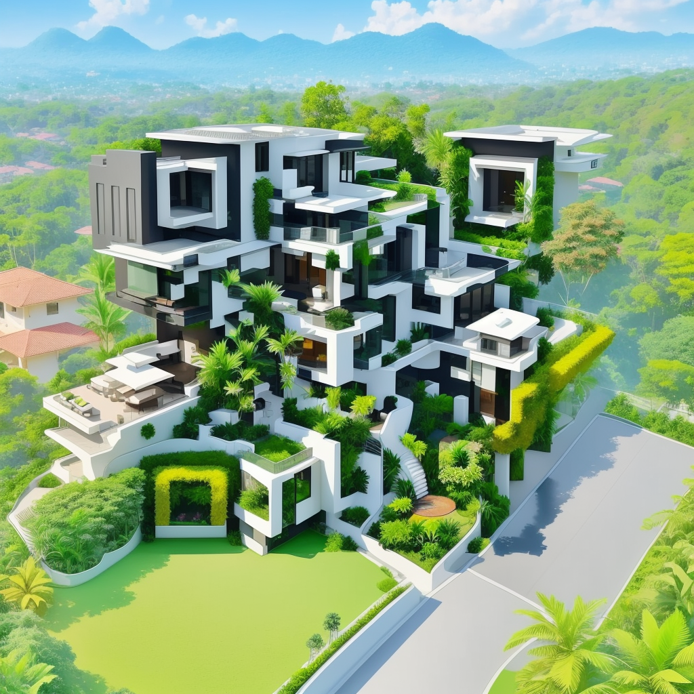

TNSDC
GENERATIVE AI FOR ENGINEERING
FINAL PROJECT
SUBMITTED BY:
SELVAKUMAR P
(311521104052)

Slide 2
QR-CODE GENERATION
Using - GENERATIVE AI

Slide 3
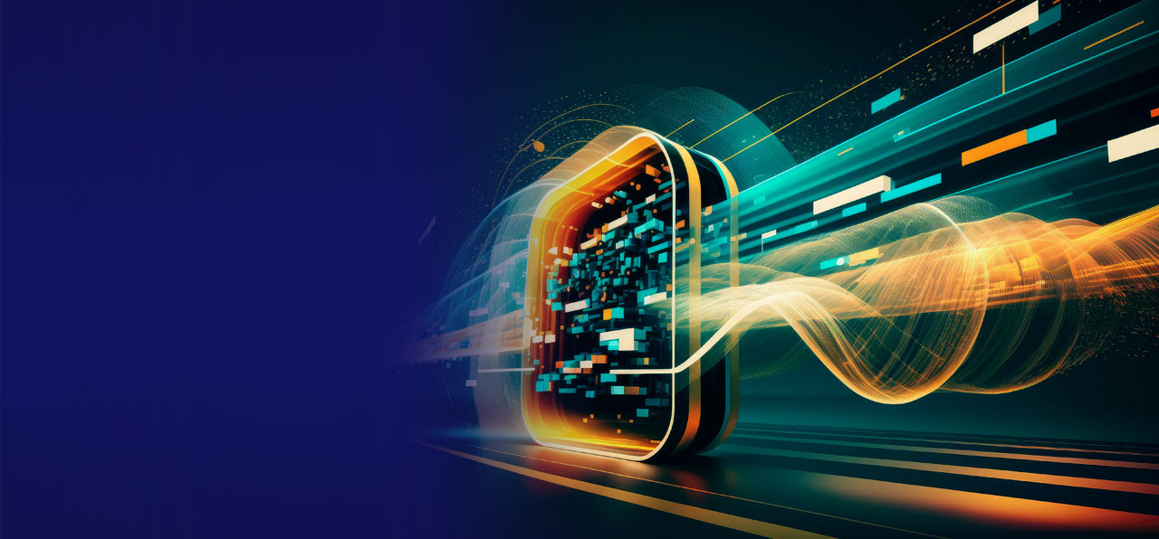
AGENDA
INTRODUCTION
Background
Generative AI Techniques for QR Code Generation
Advantages of Using Generative AI for QR Code Generation
Challenges and Considerations
Future Prospects and Research Directions
Conclusion

Slide 4

INTRODUCTION
The emergence of artificial intelligence (AI) has revolutionized various domains, including QR code generation .
QR codes have become an integral part of modern society, facilitating efficient data encoding and decoding across various industries such as marketing, logistics, and authentication. These two-dimensional barcodes offer a versatile means of transmitting information rapidly and conveniently.
Generative AI techniques, such as Generative Adversarial Networks (GANs) and Variational Autoencoders (VAEs), offer promising solutions to enhance QR code generation by enabling dynamic, customizable, and visually appealing designs.

Slide 5
BACKGROUND
Traditional QR code generation methods involve encoding data into a grid of black and white squares, resulting in static, monochromatic patterns.
Static QR codes have limitations in terms of design flexibility, customization, and visual appeal, which may hinder user engagement and adoption.
Generative AI, a subset of artificial intelligence, focuses on generating new data that mimics existing data distributions, offering potential solutions to overcome the limitations of traditional QR code generation.

Slide 6

Generative AI Techniques
GANs are deep learning models consisting of two neural networks: a generator and a discriminator. The generator generates new data samples, while the discriminator distinguishes between real and generated samples. Through adversarial training, GANs learn to generate realistic and diverse data.
VAEs are probabilistic models that learn to encode and decode data into a latent space. By sampling from the latent space, VAEs can generate new data samples that resemble the original data distribution while allowing for interpolation and exploration of latent features.
QR CODE GENERATION

Slide 7
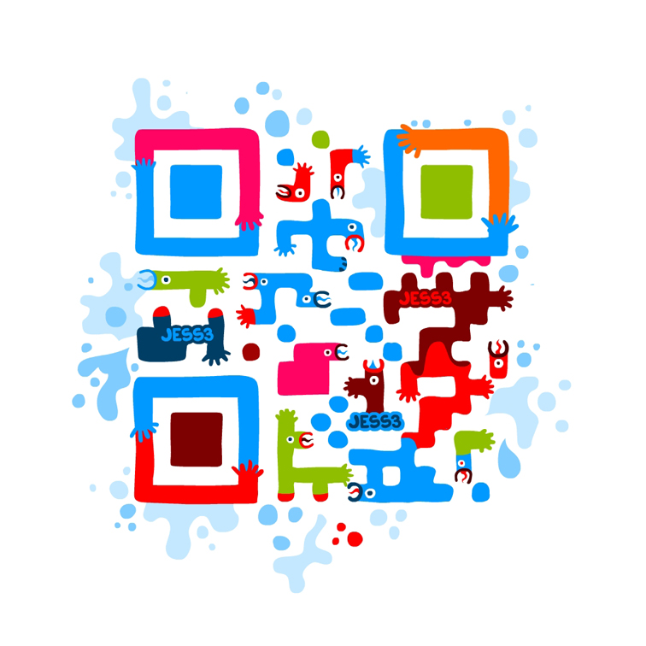
PROBLEM STATEMENT
In this project, the problem we are addressing is the conventional limitations of QR code generation. Traditional QR codes lack flexibility in design and often appear monotonous and unappealing. This restricts their effectiveness in capturing user attention and conveying brand identity. Moreover, manual customization of QR codes to align with specific branding requirements can be labor-intensive and inefficient.
By integrating AI (Artificial Intelligence) techniques, particularly deep learning and neural style transfer, we aim to revolutionize QR code design. The goal is to develop a solution that not only generates functional QR codes but also empowers users to create visually captivating codes that resonate with their brand image and marketing objectives.

Slide 8

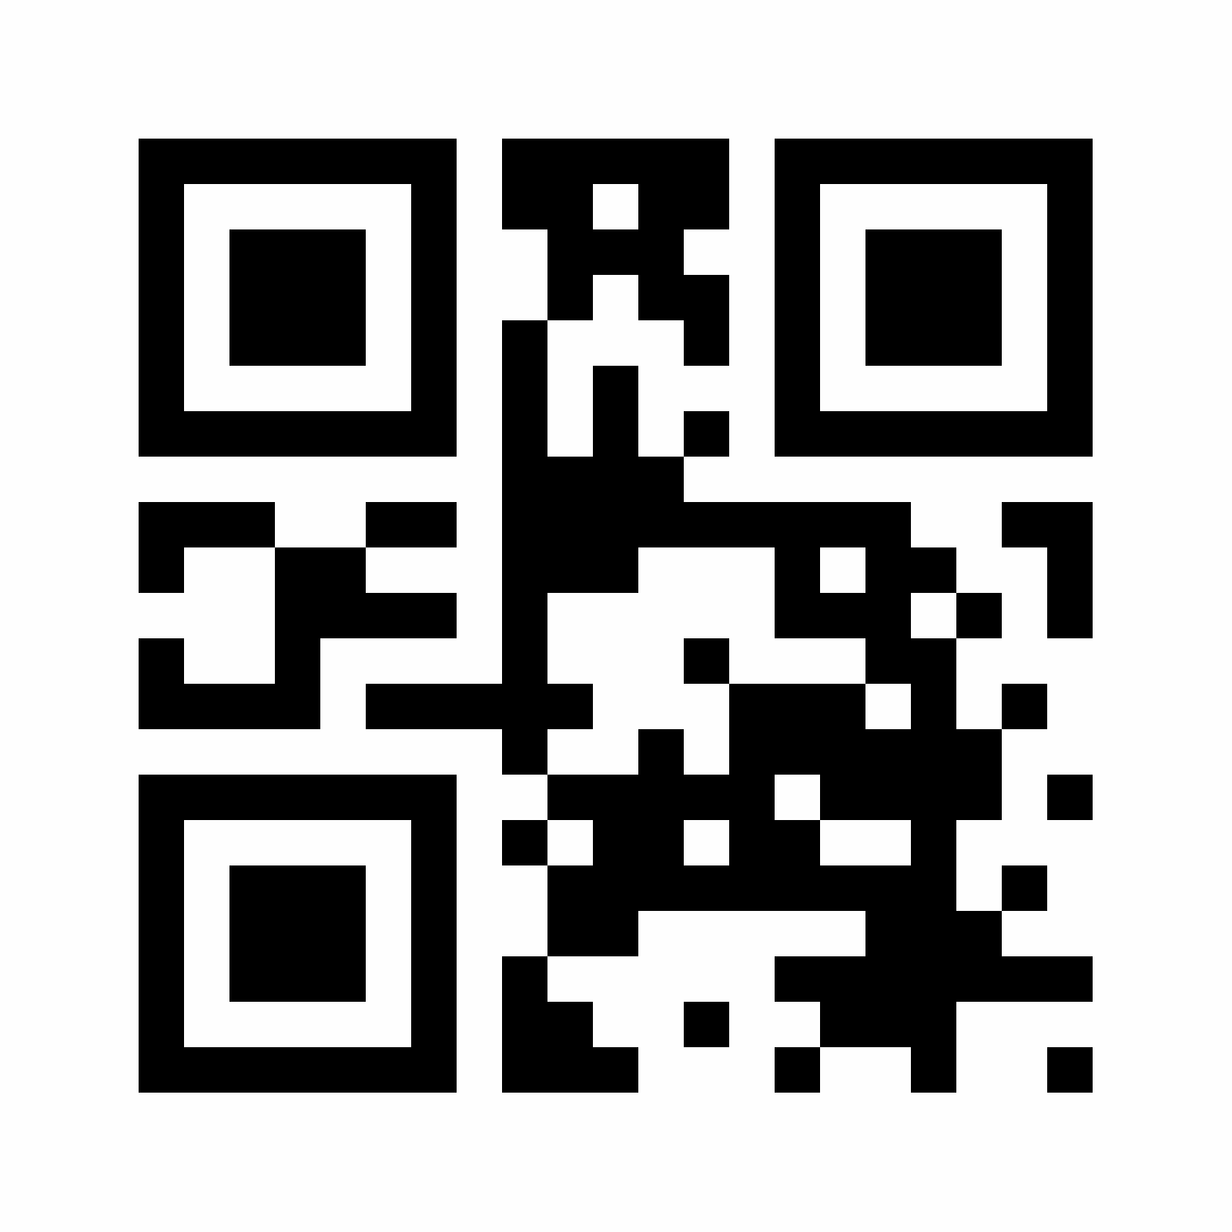
PROBLEM OVERVIEW
The project revolves around leveraging advanced AI methodologies, specifically utilizing deep learning models like VGG19, to enhance QR code generation. By harnessing the power of AI, our objective is to elevate QR code design to new heights, offering users the ability to create customized, visually appealing codes that integrate seamlessly with their brand aesthetics.
Our approach involves the fusion of cutting-edge technology with practical application, transforming QR codes from mere functional tools to dynamic elements of visual communication. Through this project, we aspire to set a new standard for QR code design that aligns with modern design trends and user expectations.

Slide 9
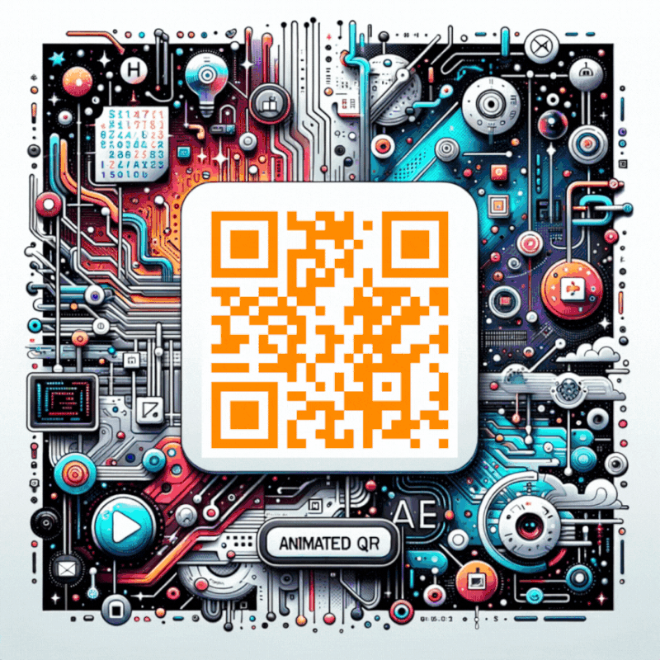
End Users
The end users of our AI-driven QR code generation solution encompass a broad spectrum of individuals and businesses:
Businesses: Seeking to embed QR codes into their marketing collateral and promotional materials.
Marketers: Utilizing QR codes for engaging campaigns and customer interactions.
Designers: Incorporating QR codes into visually appealing designs and artworks.
Individuals: Interested in creating personalized QR codes for events, personal branding, or artistic expression.
Our solution caters to anyone who values both the functionality and aesthetics of QR codes, offering a platform that empowers users to generate codes that reflect their unique style and purpose.

Slide 10
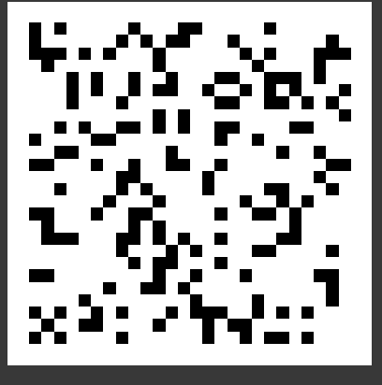
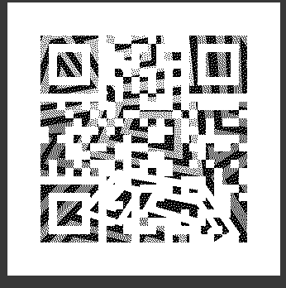
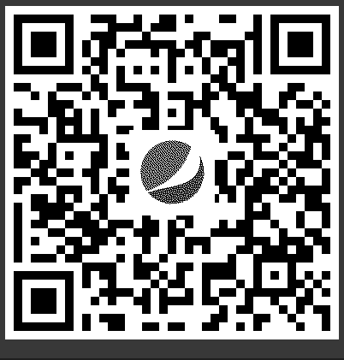
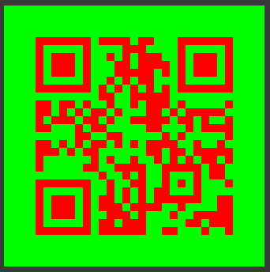
Value Proposition
Enhanced Customization: Empowering users to customize QR codes to match specific branding and design preferences.
Artistic Integration: Seamlessly blending AI-driven artistry with QR code functionality to create visually stunning codes.
Increased Engagement: Capturing audience attention and enhancing brand engagement through visually appealing QR codes.
Ease of Use: Providing a user-friendly interface that simplifies the process of generating and customizing QR codes.
Our solution aims to deliver a unique value proposition by offering a perfect blend of technology and creativity, enabling users to leverage QR codes as powerful visual assets in their marketing and communication strategies.

Slide 11



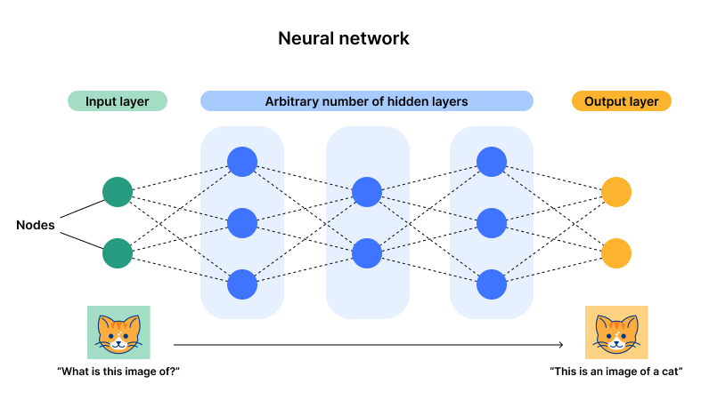
Solution
Modelling
The modelling phase of our project involves:
Utilizing VGG19: Employing VGG19, a pre-trained deep learning model, for extracting features from QR codes and style images.
Defining Custom Loss Functions: Developing custom loss functions based on Gram matrices to optimize style transfer between QR codes and artistic styles.
Optimizing Aesthetics: Iteratively refining QR code aesthetics through neural style transfer techniques to achieve visually appealing results.
Deep Learning Models
Neural Style Transfer
Customization Tools

Slide 12
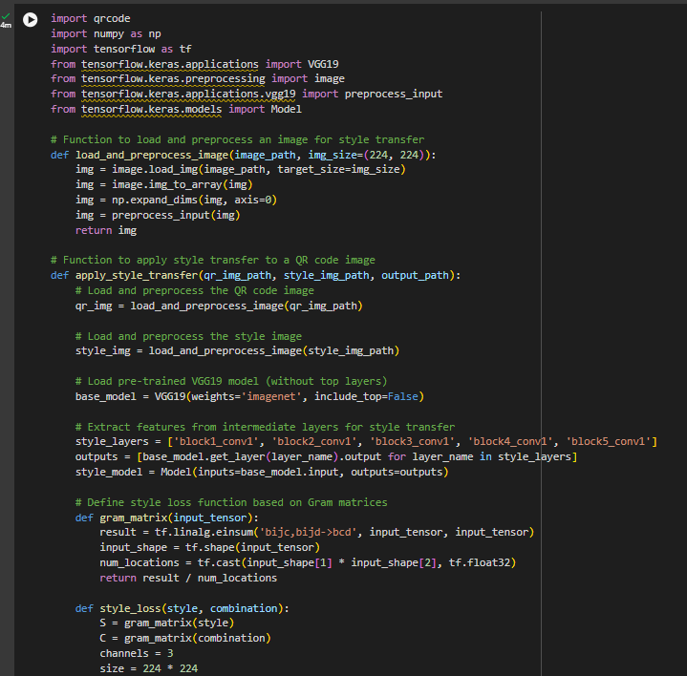
RESULTS
The results of our project demonstrate:
Successful Style Transfer: Application of style transfer techniques that enhance QR code aesthetics without compromising functionality.
Visual Appeal: Creation of visually captivating QR codes that resonate with users and enhance brand perception.
Broad Applications: Potential for broader applications in digital marketing, advertising, and brand engagement through innovative QR code design.
These results signify the transformative impact of AI-driven QR code generation, unlocking new possibilities for visual communication and branding strategies.

Slide 13
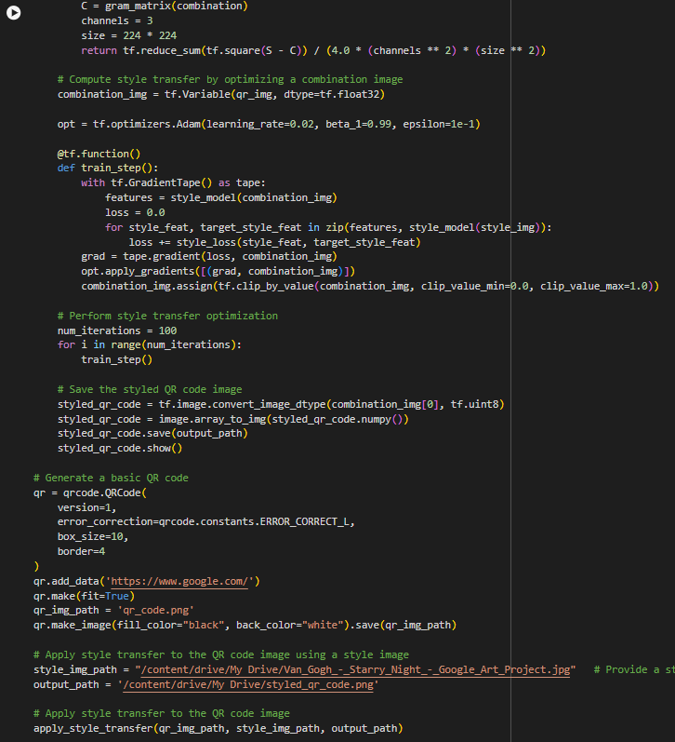
RESULTS
The results of our project demonstrate:
Successful Style Transfer: Application of style transfer techniques that enhance QR code aesthetics without compromising functionality.
Visual Appeal: Creation of visually captivating QR codes that resonate with users and enhance brand perception.
Broad Applications: Potential for broader applications in digital marketing, advertising, and brand engagement through innovative QR code design.
These results signify the transformative impact of AI-driven QR code generation, unlocking new possibilities for visual communication and branding strategies.

Slide 14
Advantages of Using Gen- AI for QR Code Generation
Enhanced Visual Aesthetics : Generative AI techniques allow for the generation of visually appealing QR code designs with intricate patterns, colors, and textures, enhancing user engagement and brand recognition.
Customization Options : Generative AI enables the customization of QR codes based on user preferences, allowing for personalized designs tailored to specific applications or contexts.
Dynamic QR Code Generation: Generative AI techniques enable the generation of dynamic QR codes that can adapt and evolve over time, providing real-time updates or interactive experiences for users.

Slide 15
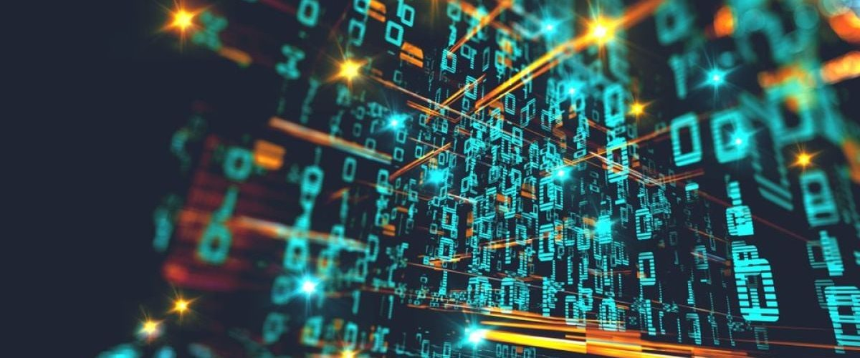
Challenges and Considerations
Data Quality and Availability : Generative AI models require large amounts of high-quality training data to learn meaningful representations. Obtaining diverse and representative QR code datasets may pose challenges in certain domains.
Computational Complexity : Training and deploying generative AI models can be computationally intensive, requiring significant computational resources and infrastructure.
QR Code Scannability : While visually appealing designs are desirable, it is essential to ensure that generated QR codes remain scannable and reliable across different scanning devices and environments.
QR CODE GENERATION

Slide 16
Future Prospects and Research Directions
RESEARCH DIRECTIONS
Future research in the field of QR code generation using generative AI may focus on addressing several key challenges and exploring new avenues for advancement.
One research direction involves improving the quality of training data to ensure that generative AI models can effectively learn diverse QR code patterns and designs.
Additionally, optimizing model performance and scalability is essential for deploying generative AI algorithms in real-world applications, particularly in scenarios requiring rapid QR code generation at scale.
Furthermore, exploring novel generative AI architectures tailored specifically to QR code generation could lead to breakthroughs in design creativity, scanability, and usability.

Slide 17
CONCLUSION
In conclusion, the integration of generative AI techniques offers significant opportunities for revolutionizing QR code generation. By harnessing the power of GANs, VAEs, and other generative AI algorithms,
QR codes can be transformed into dynamic, customizable, and visually appealing assets with enhanced functionality and user engagement. While challenges remain, continued research, interdisciplinary collaboration, and innovation hold the key to unlocking the full potential of QR code technology in the digital age.
Summarize the key findings and outcomes of the project, highlighting the success of using generative AI for QR code generation.
Reflect on the project's contributions to the field of QR code technology and the broader implications for information encoding and communication.
Source code @github: https://github.com/SELVAENGINER/GEN-AI-

Slide 18

T H A N K Y O U

